Slide 1
Surface Polishing
Contractor: Example Contractor
Client: Example Client
Agreement #111-11-11 dated 01.11.2024
Structure type F6
Construction count: 2 pcs.
Installation address: Sample District, Example Street 137A, pedestrian area
Reporting period: 01.12.2024-31.12.2024

Slide 2
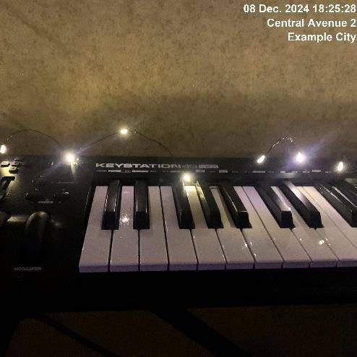
08.12.2024
Construction 1
Surface polishing required

Slide 3
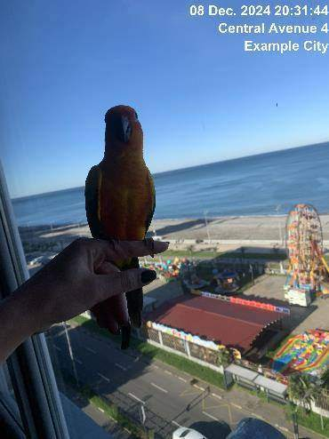
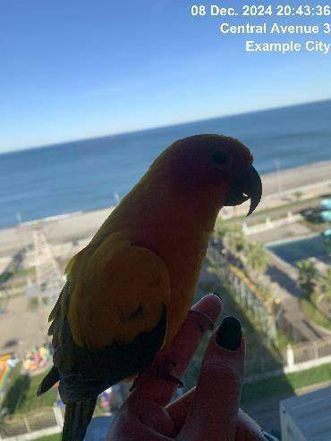
08.12.2024
Construction 1
Surface polished

Slide 4
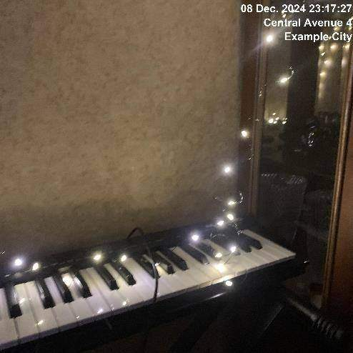
08.12.2024
Construction 1
Issue resolved

Slide 5
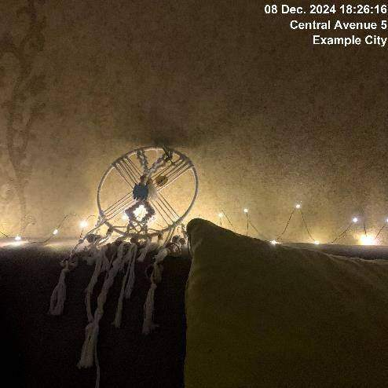
08.12.2024
Construction 2
Surface polishing required

Slide 6
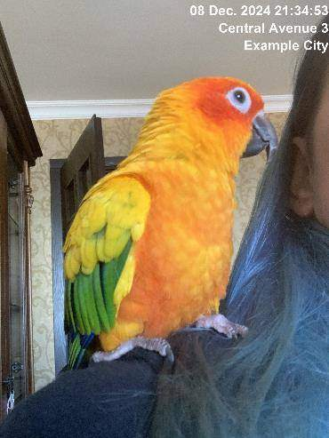

08.12.2024
Construction 2
Surface polished

Slide 7
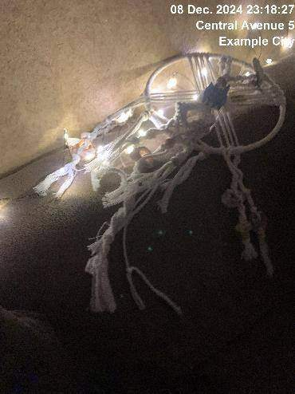
08.12.2024
Construction 2
Issue resolved

Slide 8
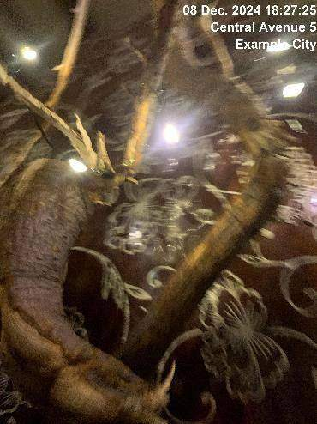
08.12.2024
Construction 3
Surface polishing required

Slide 9
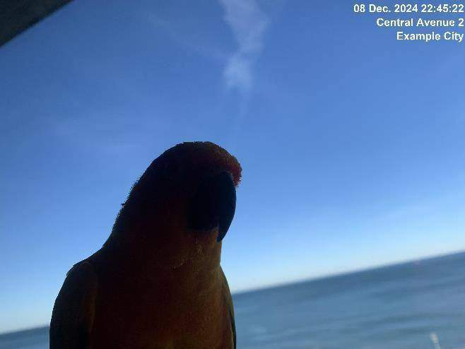
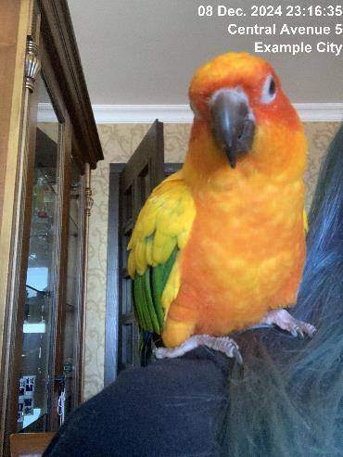
08.12.2024
Construction 3
Surface polished

Slide 10
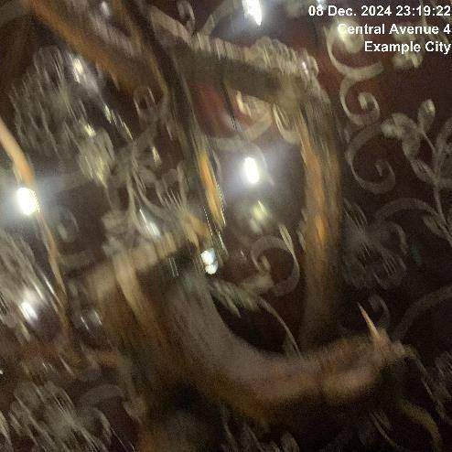
08.12.2024
Construction 3
Issue resolved

Slide 11
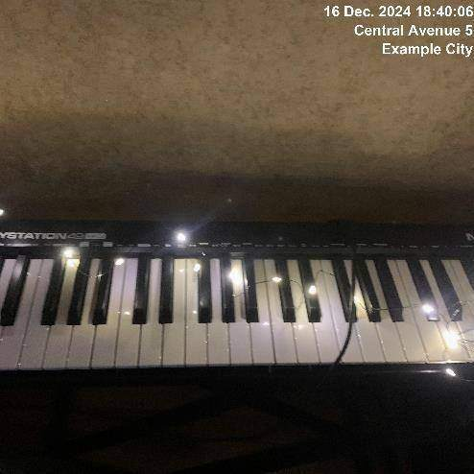
16.12.2024
Construction 1
Surface polishing required

Slide 12
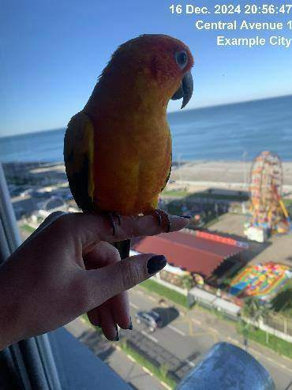
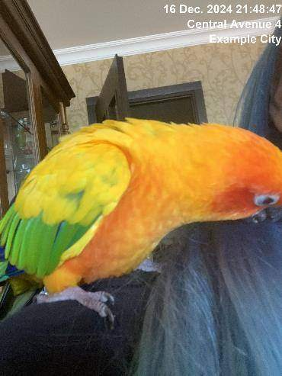
16.12.2024
Construction 1
Surface polished

Slide 13
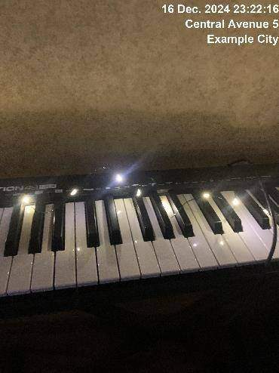
16.12.2024
Construction 1
Issue resolved

Slide 14
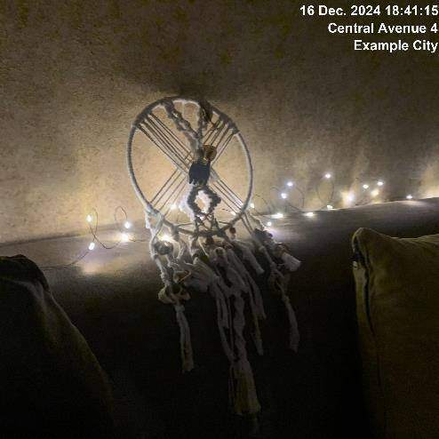
16.12.2024
Construction 2
Surface polishing required

Slide 15
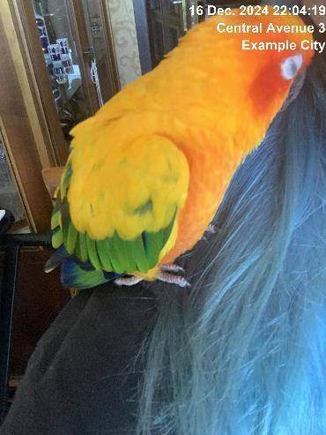
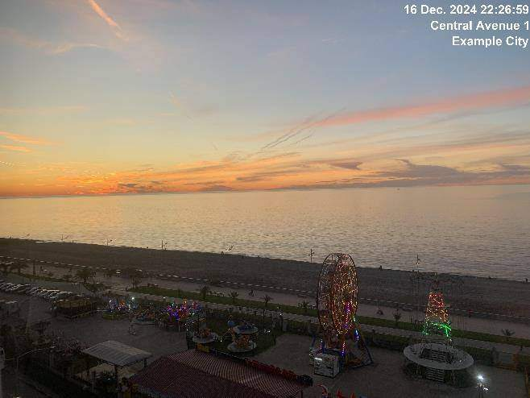
16.12.2024
Construction 2
Surface polished

Slide 16
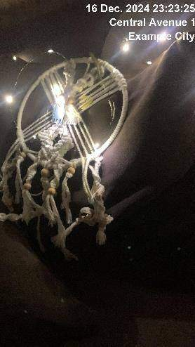
16.12.2024
Construction 2
Issue resolved

Slide 17
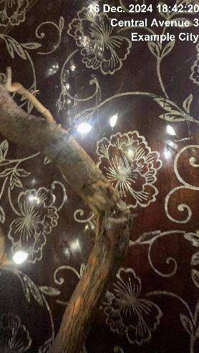
16.12.2024
Construction 3
Surface polishing required

Slide 18
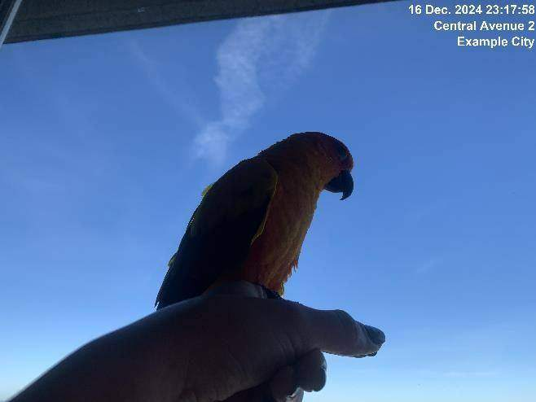
16.12.2024
Construction 3
Surface polished

Slide 19

16.12.2024
Construction 3
Surface polished

Slide 20
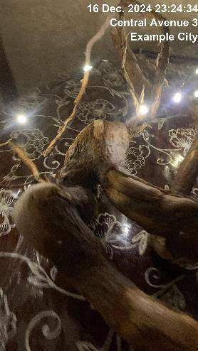
16.12.2024
Construction 3
Issue resolved

Slide 21
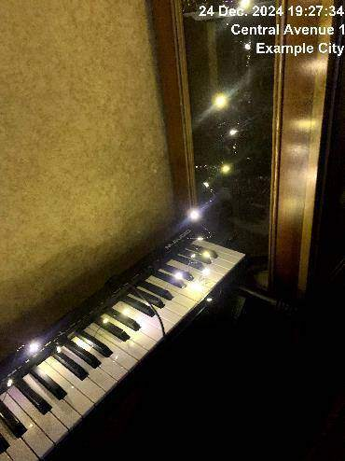
24.12.2024
Construction 1
Surface polishing required

Slide 22
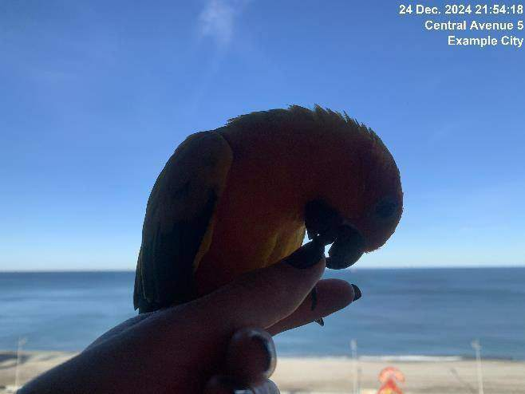
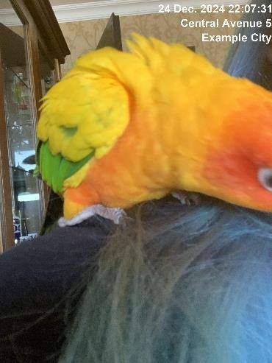
24.12.2024
Construction 1
Surface polished

Slide 23
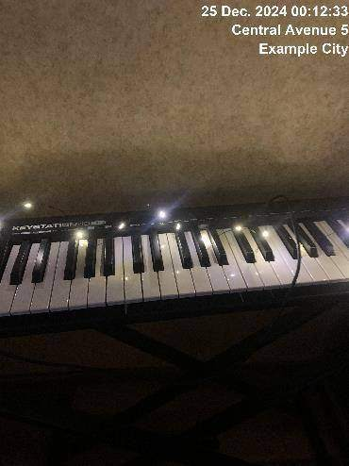
24.12.2024
Construction 1
Issue resolved

Slide 24
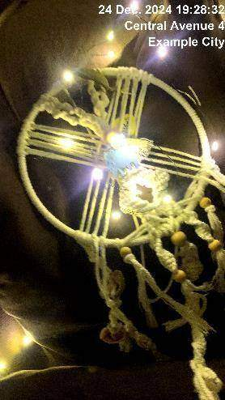
24.12.2024
Construction 2
Surface polishing required

Slide 25
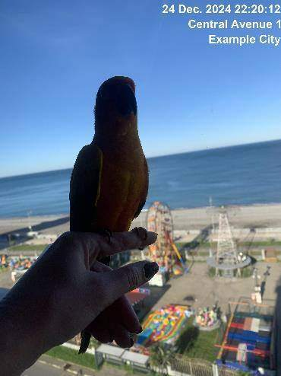
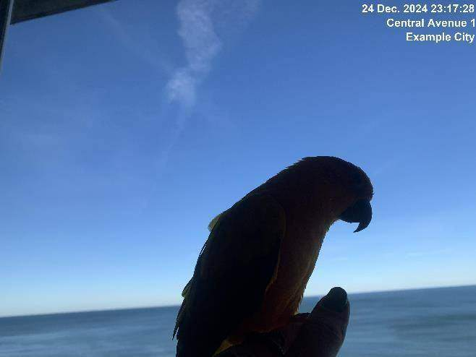
24.12.2024
Construction 2
Surface polished

Slide 26
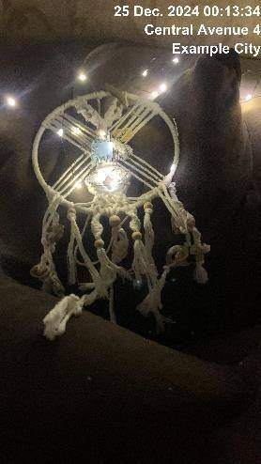
24.12.2024
Construction 2
Issue resolved

Slide 27

24.12.2024
Construction 3
Surface polishing required

Slide 28
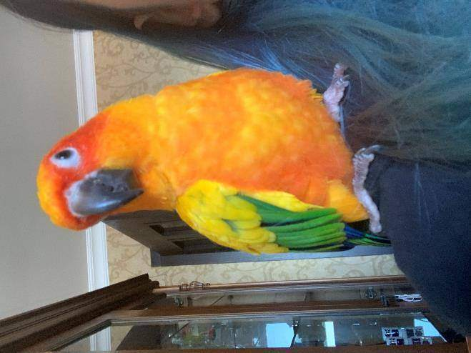
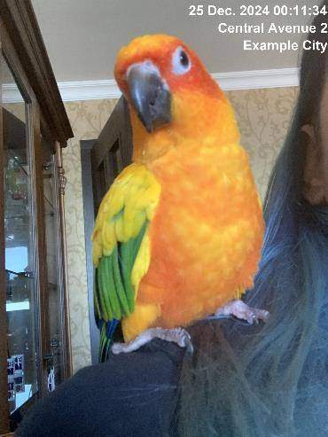
24.12.2024
Construction 3
Surface polished

Slide 29
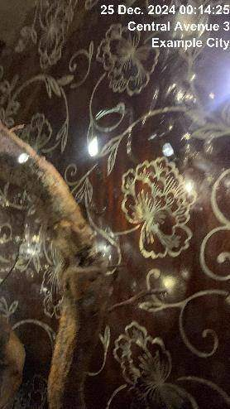
24.12.2024
Construction 3
Issue resolved

Slide 30
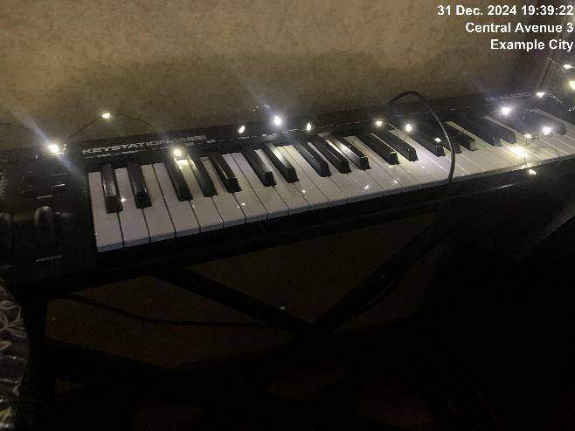
31.12.2024
Construction 1
Surface polishing required

Slide 31
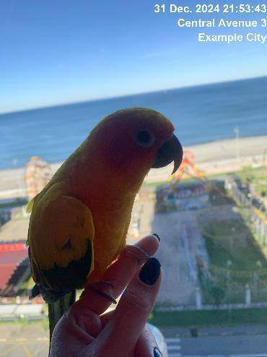
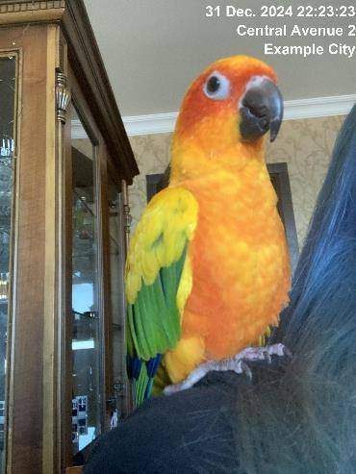
31.12.2024
Construction 1
Surface polished

Slide 32
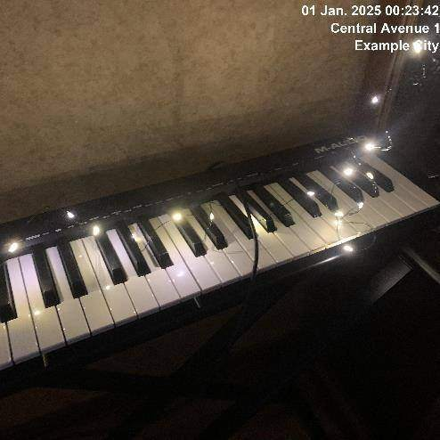
31.12.2024
Construction 1
Issue resolved

Slide 33
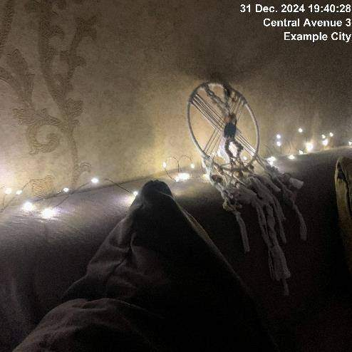
31.12.2024
Construction 2
Surface polishing required

Slide 34
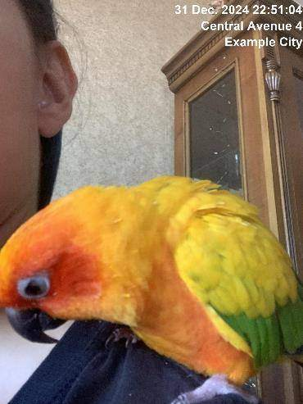
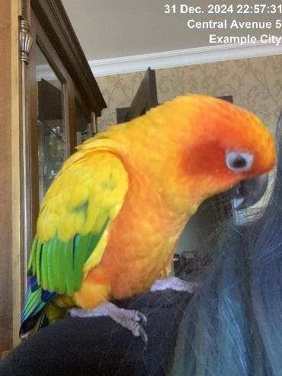
31.12.2024
Construction 2
Surface polished

Slide 35
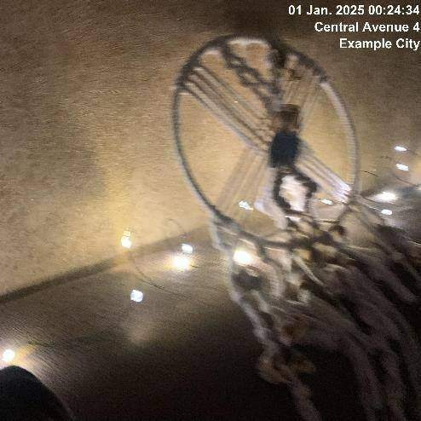
31.12.2024
Construction 2
Issue resolved

Slide 36
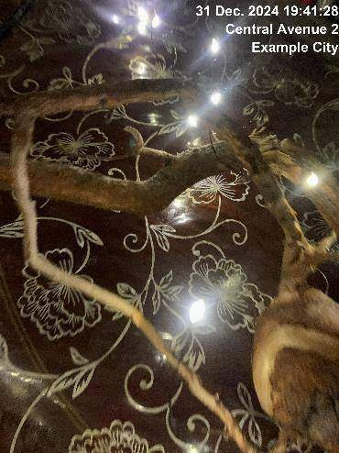
31.12.2024
Construction 3
Surface polishing required

Slide 37
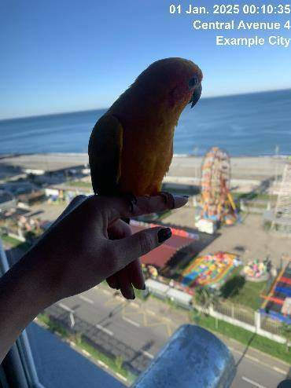
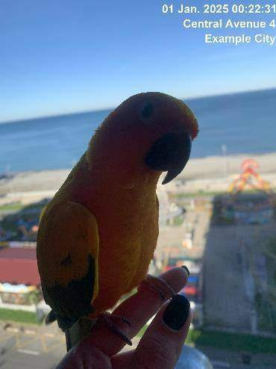
31.12.2024
Construction 3
Surface polished

Slide 38
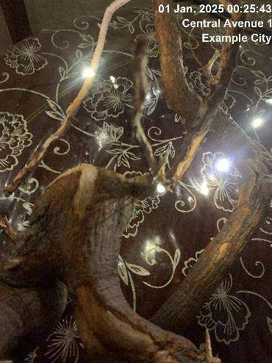
31.12.2024
Construction 3
Issue resolved

